Slide 1


RidePulse Nairobi – Demand Prediction Model
Subtitle
Optimizing Demand Prediction with Ensemble & Neural Networks
Team: Charles Mutembei, Kelvin Kipkorir, Lucy Mutua, Sharon Aoko, Victor Musyoki

Slide 2

Problem Statement
Nairobi’s ride-pulse drivers lose 30% of their day cruising empty—while 20% of ride requests go unfulfilled. This inefficiency costs riders and drivers millions daily.
Root Cause: No predictive tools
Impact: Approximately KSH 5M/day collective loss.

Slide 3

Objective: 1. Saves fuel/time for drivers. 2. Reduces passenger wait times. 3. Scales to 5,000+ riders citywide.

Slide 4
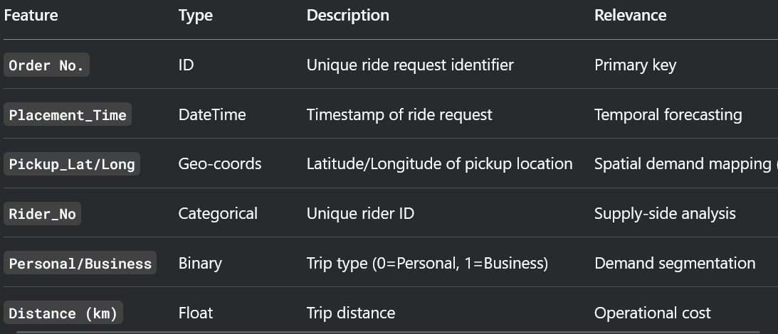
Dataset OVERVIEW
Source: Zindi Africa – Sendy Logistics Challenge
Size: 20K rows (sample from Nairobi)
Time Period: 6 months (2022)
Coverage: Nairobi and peripheral zones (such as Kitengela, Athi River)

Slide 5

Data Cleaning & Preprocessing
Libraries Used:
Pandas : For Cleaning
H3-Py : For Spatial Indexing
Scikit –Learn : For Preprocessing
CatBoost Model: For predicting demand_count

Slide 6
Model Result and Evaluation
Metric | CatBoost | LightGBM | Difference
MAE | 0.41 | 0.43 | 4.9% (worse)
Training Time | 45 sec | 35 sec | 22% (faster)

Slide 7

Limitations:
. Data gaps (holidays/weather), CatBoost speed (20% slower).
Future Plans:
. Add traffic/weather data, test GNNs, dynamic pricing.

Slide 8
Conclusion & Recommendation
What we have learned:
CatBoost slightly outperformed LightGBM (MAE 0.41 vs. 0.43) due to its superior handling of categorical features like h3_cell
LightGBM was 29% faster in training (~35 sec vs. 45 sec), making it better for rapid iterations
Critical Features
h3_cell that is location and hour_of_day were top predictors, confirming demand varies sharply by zone/time.
Recommendations
Deploy CatBoost (MAE 0.41, 45sec training).
Add weather data (e.g., rain spikes).
Pilot rider incentives (hotspot bonuses).

Slide 9

Blank slide
Thank you
Any Questions?

